Slide 1

RPI Book Shopping
System
Huiyu Ma (Leader)
Hanyang Guan
Xueyang Guan

Slide 2
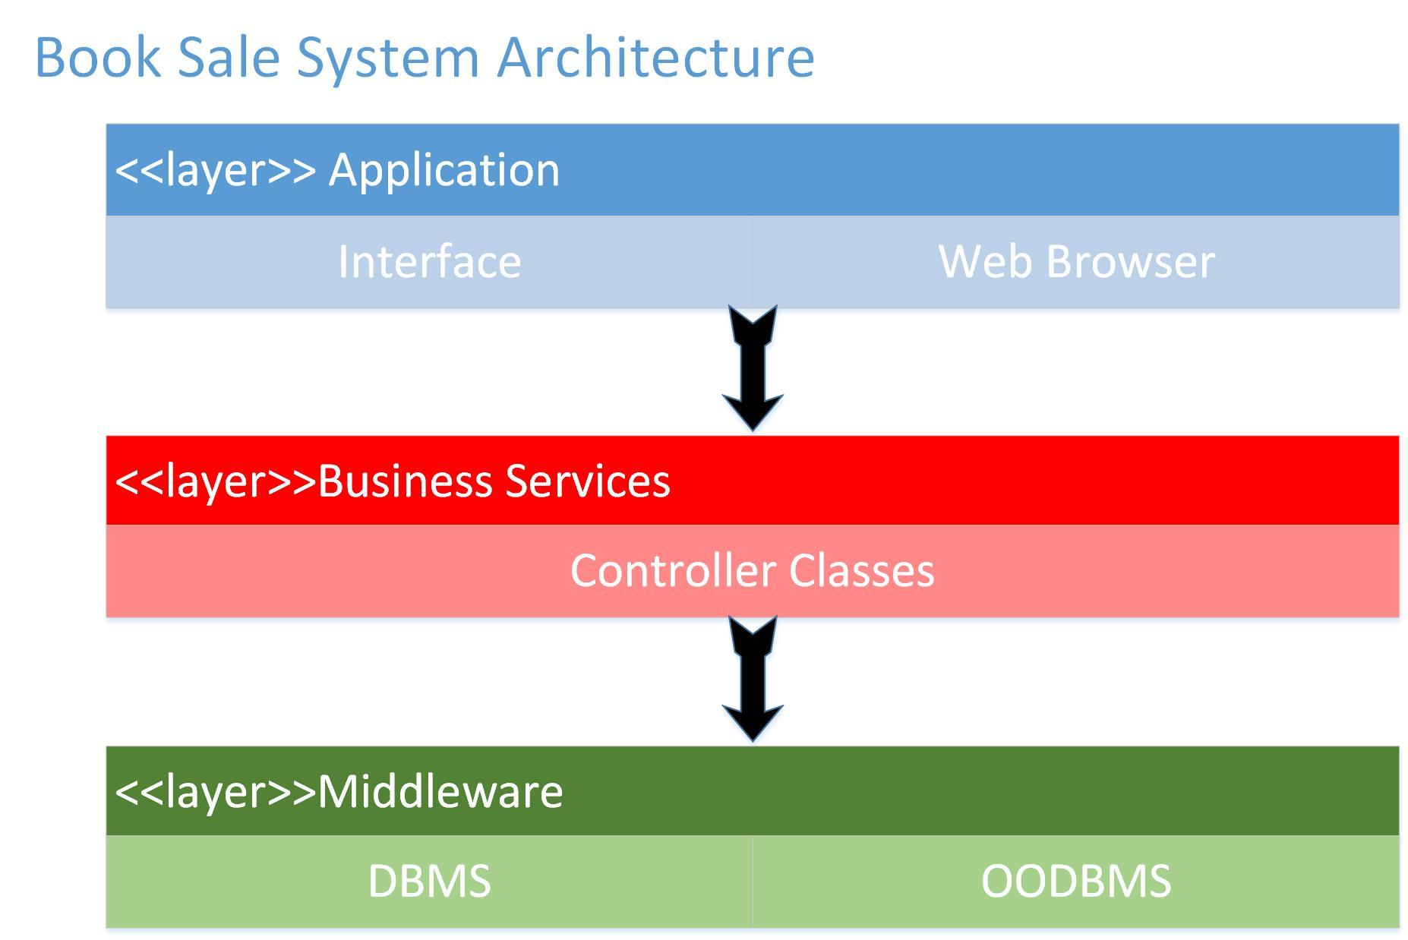
N-tier Architecture

Slide 3
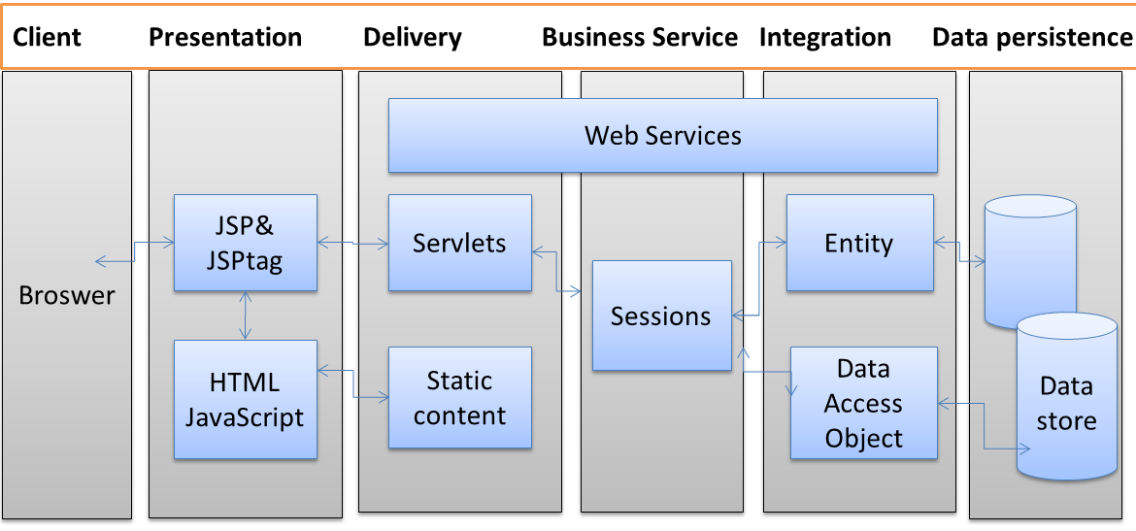

Slide 4
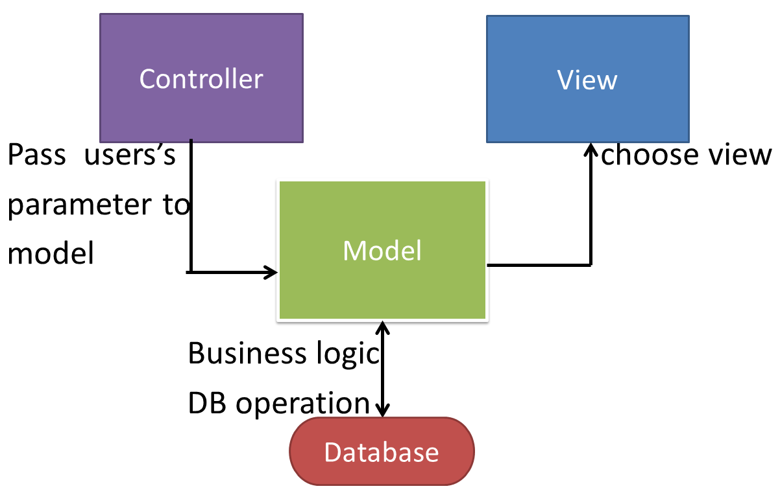
MVC model
User

Slide 5
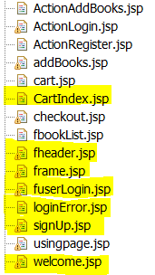
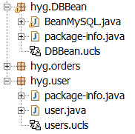
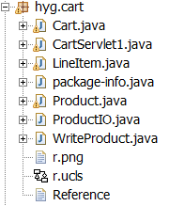
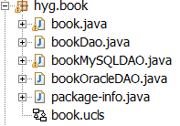
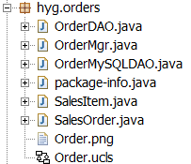
MVC model
Controller&View Model

Slide 6
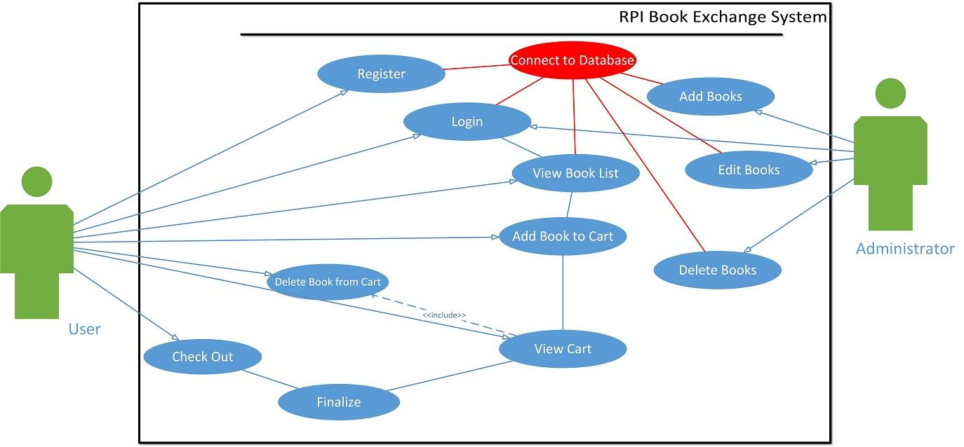
Use Case

Slide 7
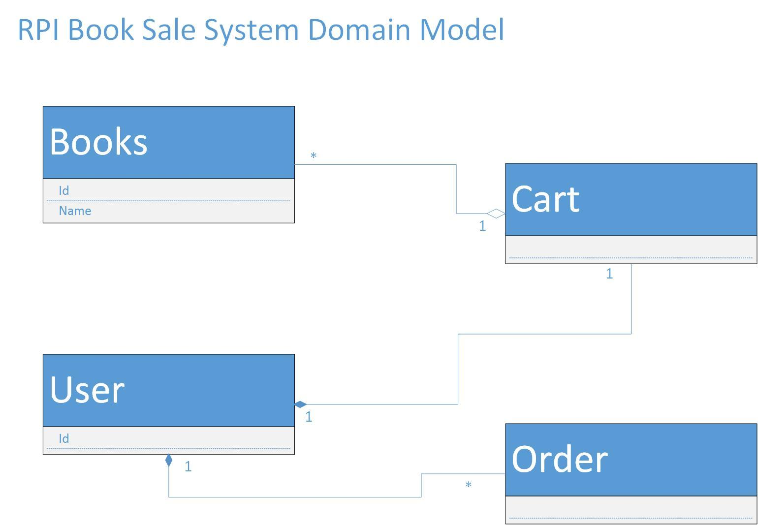
Domain Model

Slide 8
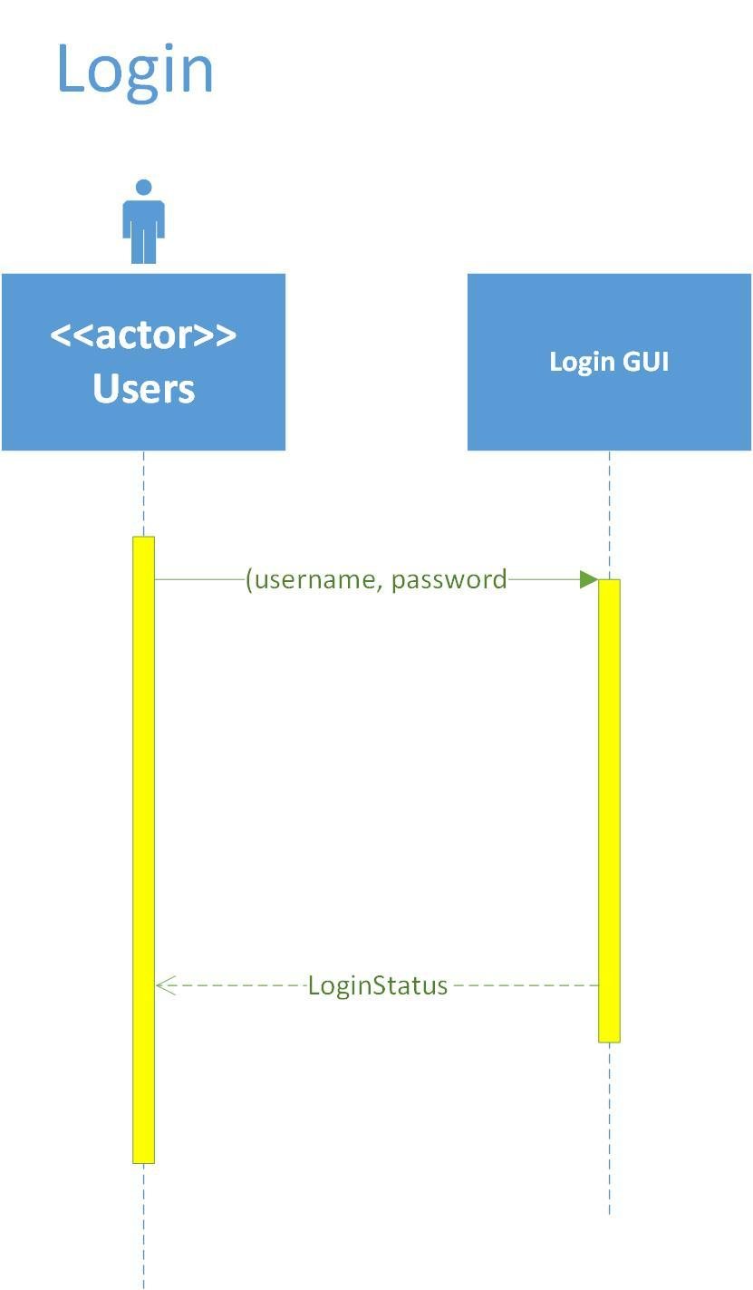
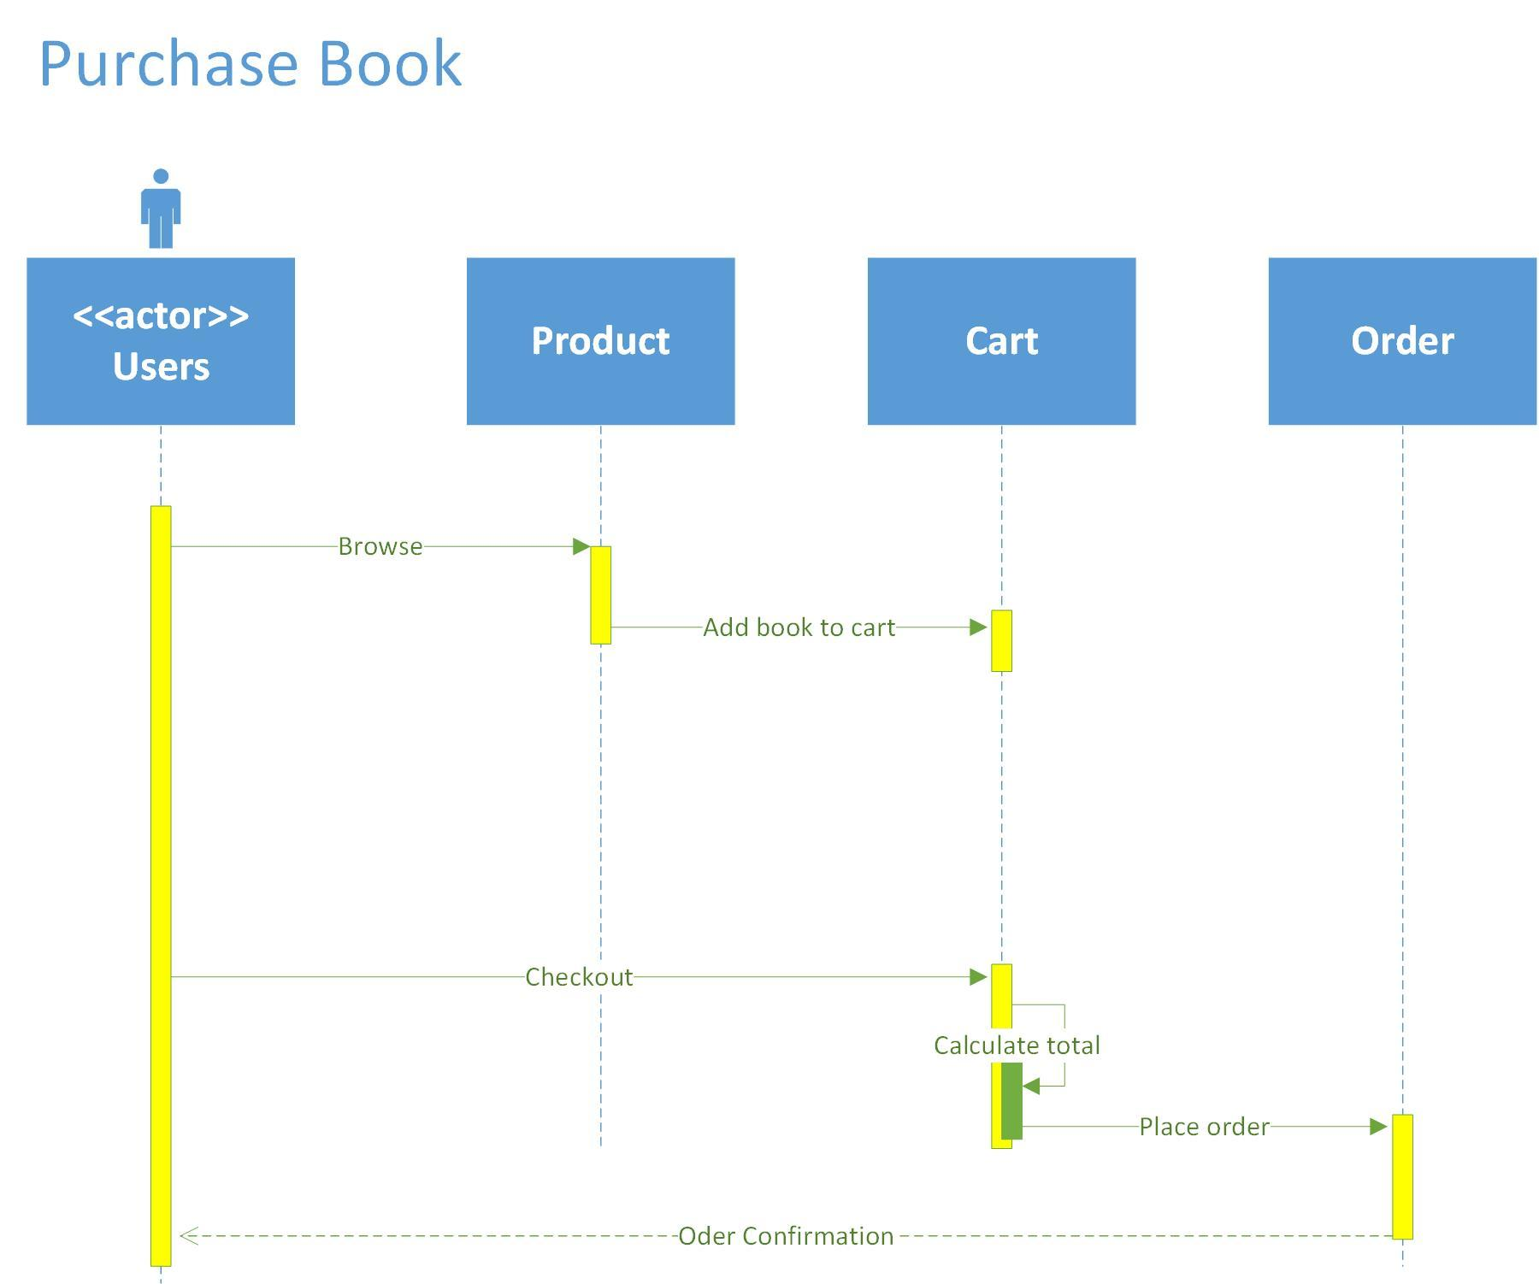
Sequential Diagram

Slide 9
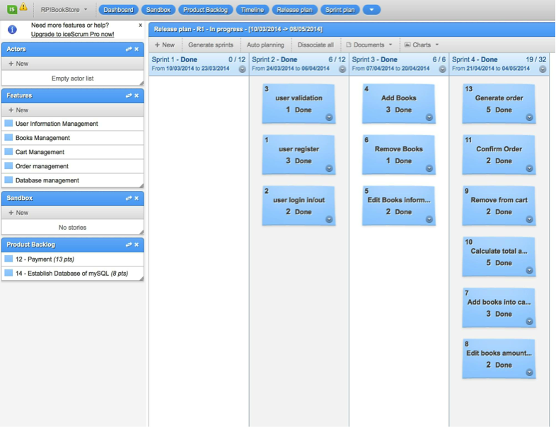
iceScrum

Slide 10
JUnit
package hyg.book;
import static org.junit.Assert.*;
import org.junit.Test;
public class bookTest {
@Test
public void testSetbookname() {
// book is tested
book tester = new book();
tester.Setbookname("Software Development");
// check if Setbookname("Software Development") reset the value of bookname
assertEquals("Setbookname("Software Development") change the book name", "Software Development", tester.Getbookname());
}
}

Slide 11
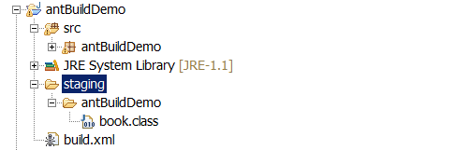
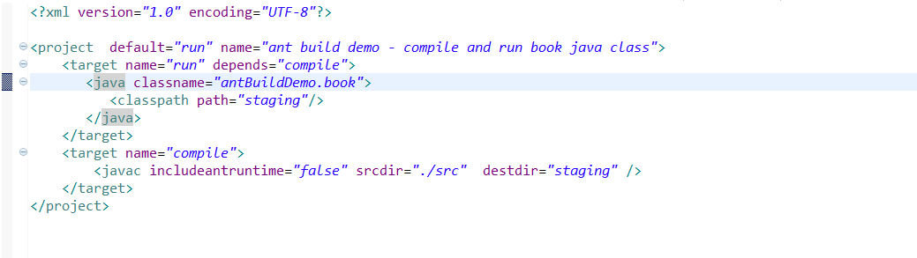
Ant

Slide 12
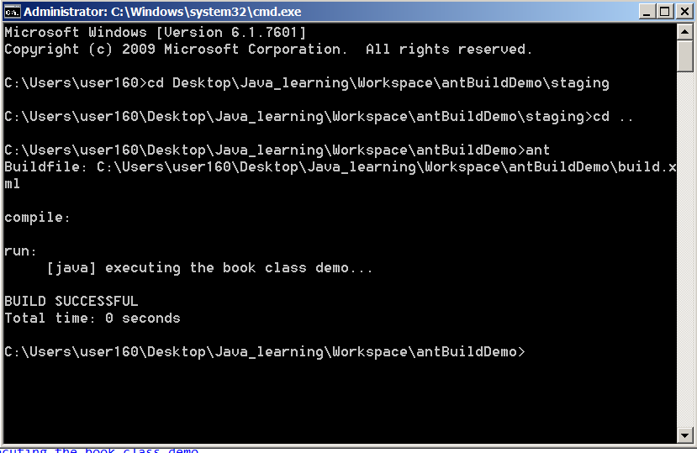
Ant

Slide 13
Thank you

Slide 14
Any Questions

